Slide 1
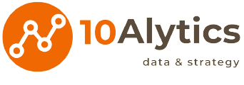


Recruitment Case Study
TedSquare Limited

Slide 2
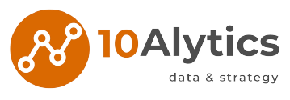

Recruitment
It’s been two years since COVID-19 was declared a global pandemic. TedSquare Ltd is barely keeping afloat from the pandemic effects and urgently needs to make critical business decisions to change the tide. Management is implementing cost reduction techniques in most departments and the hammer is about to fall on the recruiting function in HR department.
You have been contacted as a HR Analytics consultant to provide an in-depth analysis to enable management make an informed decision on the most effective recruitment method to funnel investments and the potential benefits, risks/consequences associated with the choice.

Slide 3

Create a dashboard and share on LinkedIn
(Tag @10Alytics)

